Slide 1
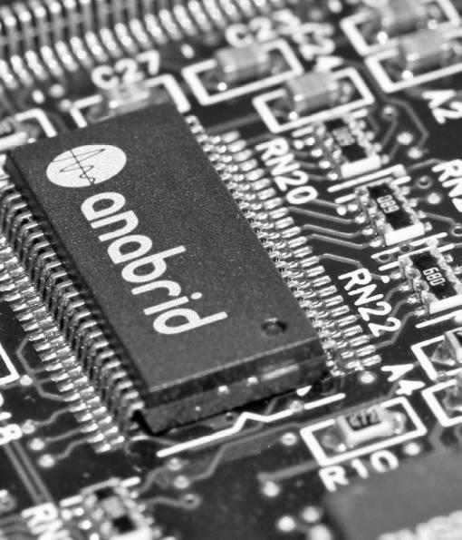
Analog architectures on FPGAs and ASICs
Dr. Sven Köppel
koeppel@anabrid.com
2025-07-14, 10:30 AM
Paderborn Center for Parallel Computing (PC2)
PC2 Seminar at U Paderborn
Room X0.101, Mersingweg 5, 33098 Paderborn

Slide 2
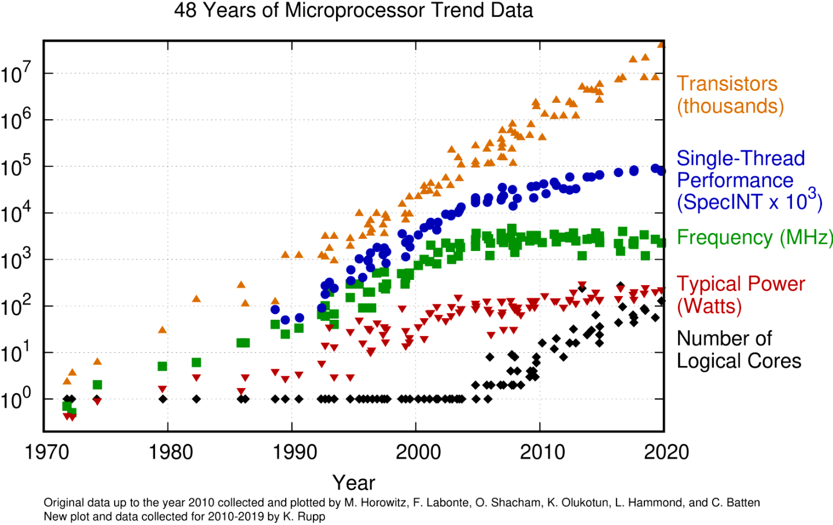
Bildquellen: wccftech.com

Slide 3

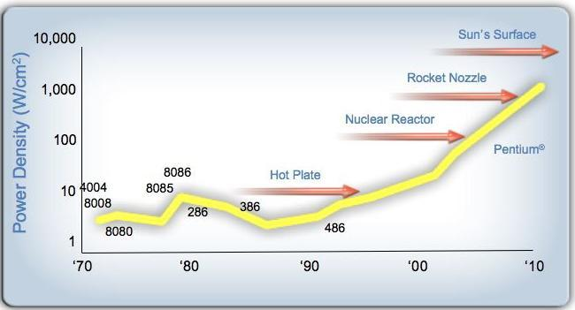
Moore’s Law: Advances only at Parallelization, no more at clock frequency
„Energy barrier“
Bildquellen: wccftech.com

Slide 4
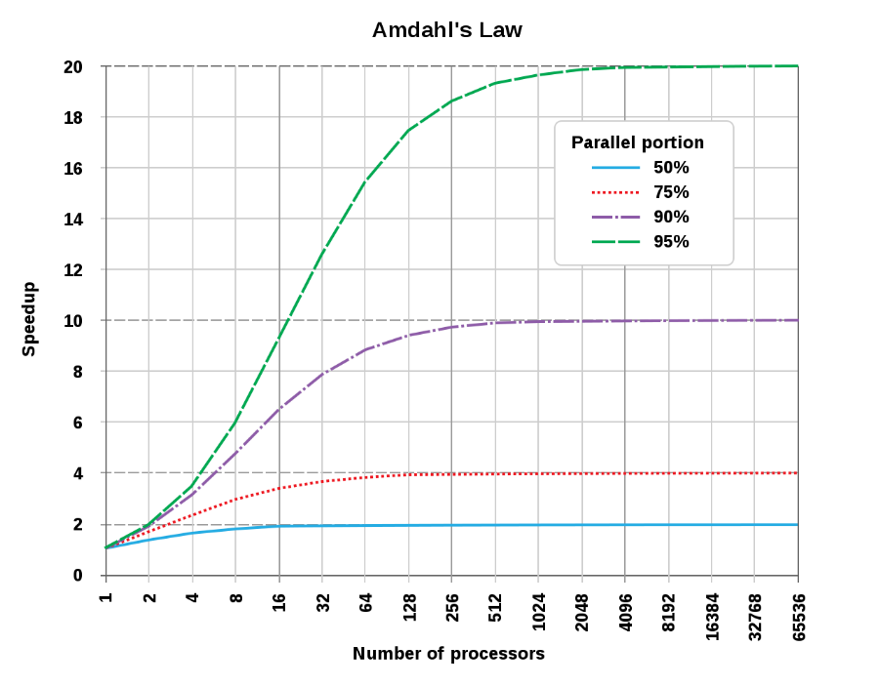
Limits of Parallelizability: Amdahl’s Law
Manycore architectures and high-performance clusters enable progress.
But the energy cost is very high!
With 95% parallel portion:
3000 x computers (performance)
but only 20 x speedup
Bildquellen: Rebooting the IT-Revolution, Semiconductor Research Coorp 2015; extremetech.com; IBM; Special credits to Damian D. für die Slide und Abbildungen!

Slide 5
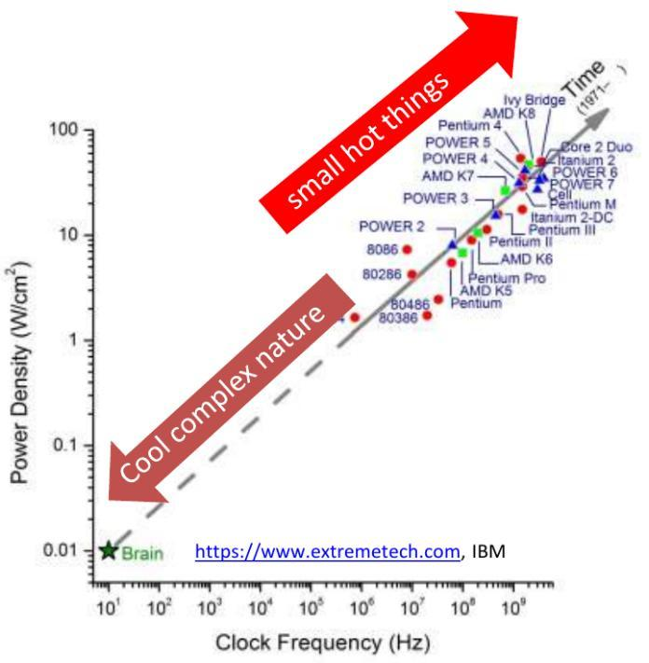
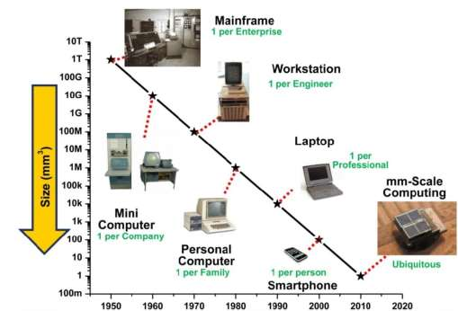
Heat generation: Energy and component size
Modern semiconductor manufacturing processes enable progress.
However, the energy cost is very high.
Bildquellen: Rebooting the IT-Revolution, Semiconductor Research Coorp 2015; extremetech.com; IBM; Special credits to Damian D. für die Slide und Abbildungen!

Slide 6
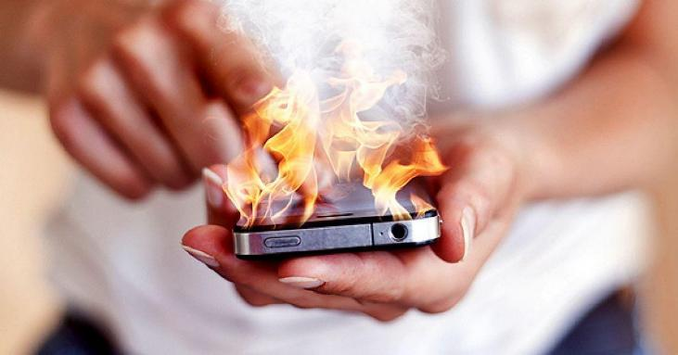
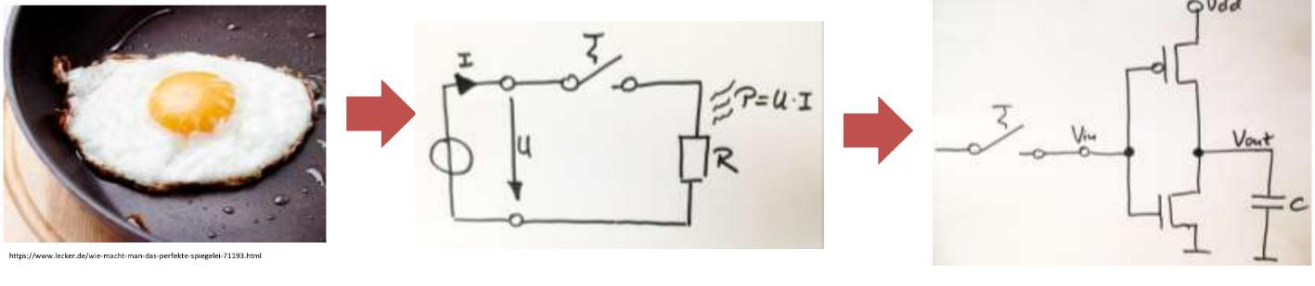
The final frontier for computer heat production
Landauer Principle! [R. Landauer 1961]
Landauer Limit (at room temperature):
„Energy barrier“
Heat dissipation in CMOS circuits increases significantly with the integration of components.
Bildquellen: mann.tv (iPhone verbrennt Mutter), wccftech.com; Special credits to Damian D. für die Slide und Abbildungen!

Slide 7
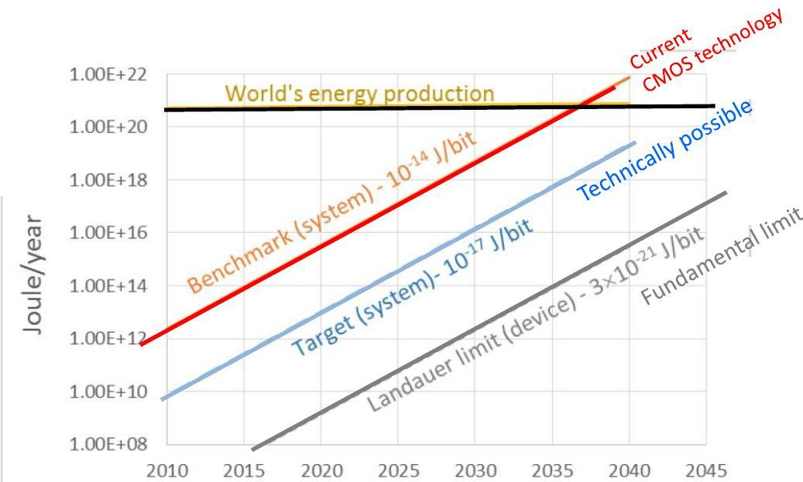
Switching generates Heat: A globally significant amount of it!
„Information catastrophe“
Already today, 7% of global energy is consumed by the information sector.
Climate change?
Bildquellen: semiconductors.org; Special credits to Damian D. für die Slide und Abbildungen!

Slide 8
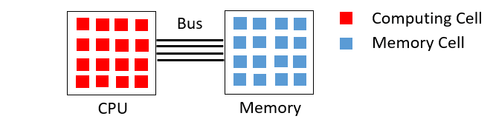
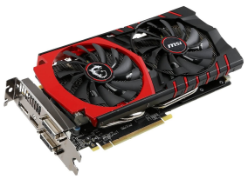
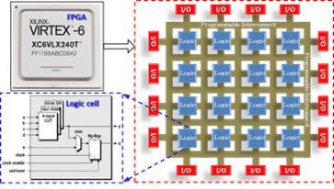
Digital architectures: Summary
Energy barrier: Clock speed can no longer increase.
Amdahl’s Law: Parallelizability has its limits.
Von Neumann bottleneck: Conventional Computer architecture limits performance.
Digital Alternatives exist, for instance
GPGPUs
FPGAs

Slide 9
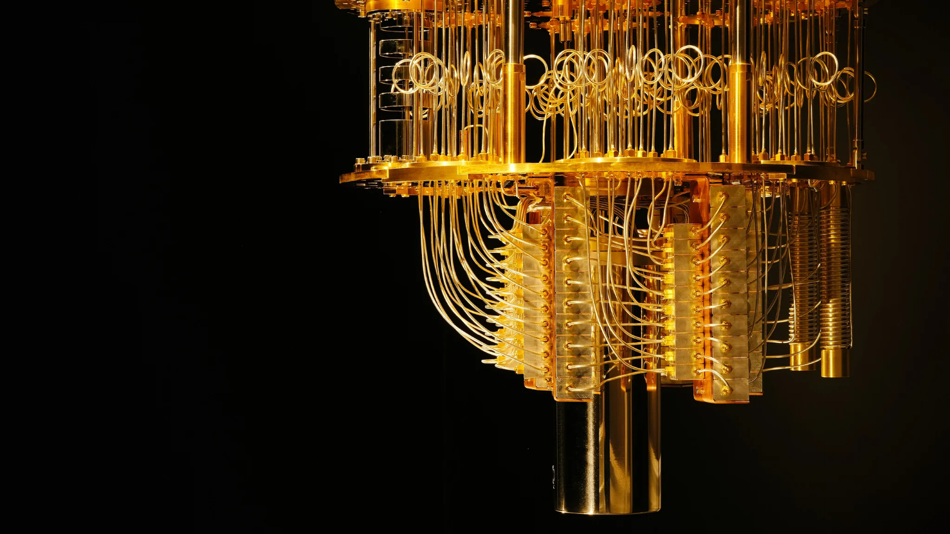
Exotic Computing:
Fundamental research
Silicon alternatives, for instance
Graphene
Photonic Computing
Quantum Computing
Neuromorphic Computing
Computational Memory, e.g. Memristors
Analog Computing
Extensive materials research
Many interdisciplinary connections
IBM Q System One

Slide 10
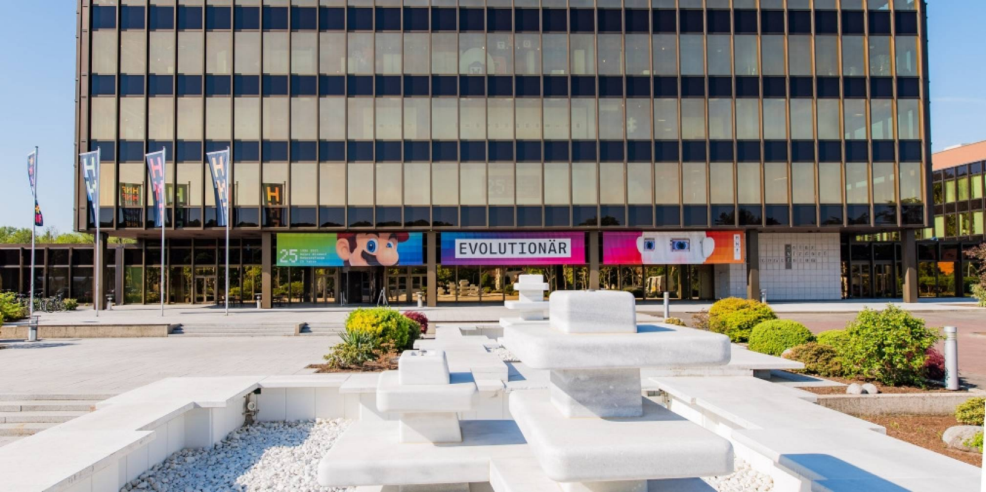
Heinz-Nixdorf-Forum (Computer Museum) in Paderborn

Slide 11
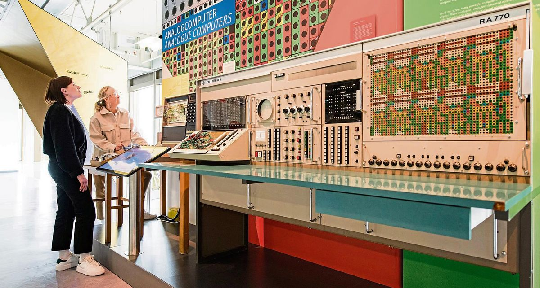
Telefunken Analog Computer from 1960s → www.analogcomputermuseum.org

Slide 12
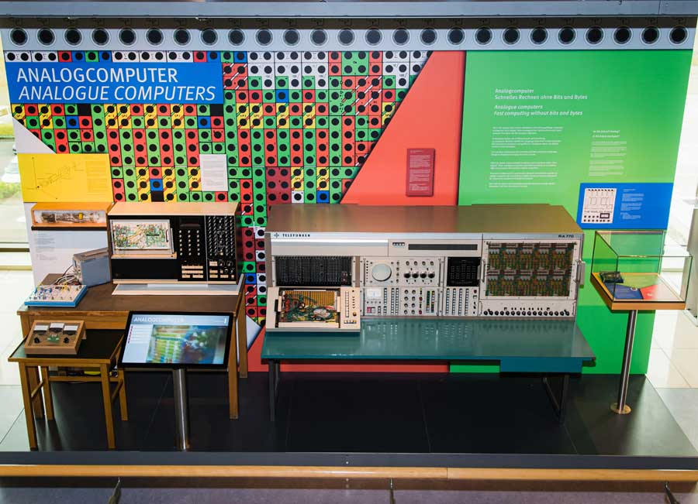

Slide 13
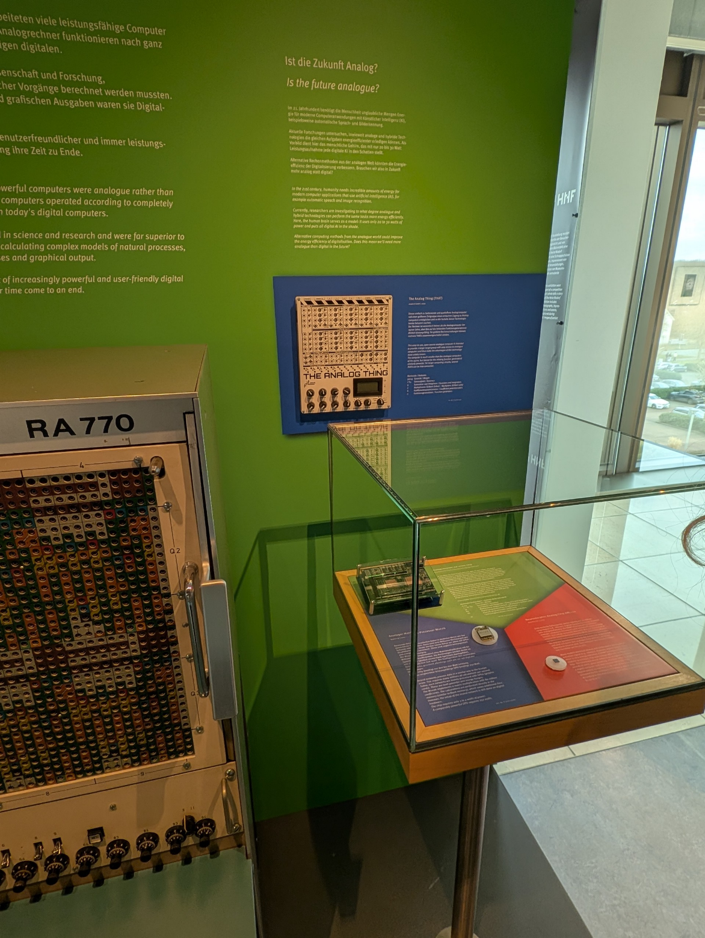

Slide 14
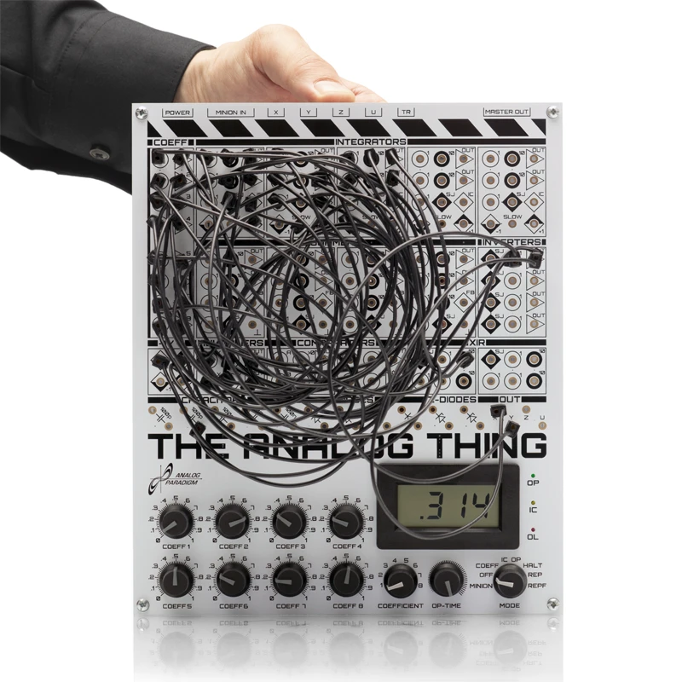
The Analog Thing
Affordable computer for
education and teaching.
Open Source Hardware invites tinkering and „hacking“.
Discrete CMOS and no processor, only a digital state machine.
3V3 A&D interface for
Arduino, Raspberry Pi, etc.
No electronic lab equipment neccessary (can use sound card instead oscilloscope)

Slide 15
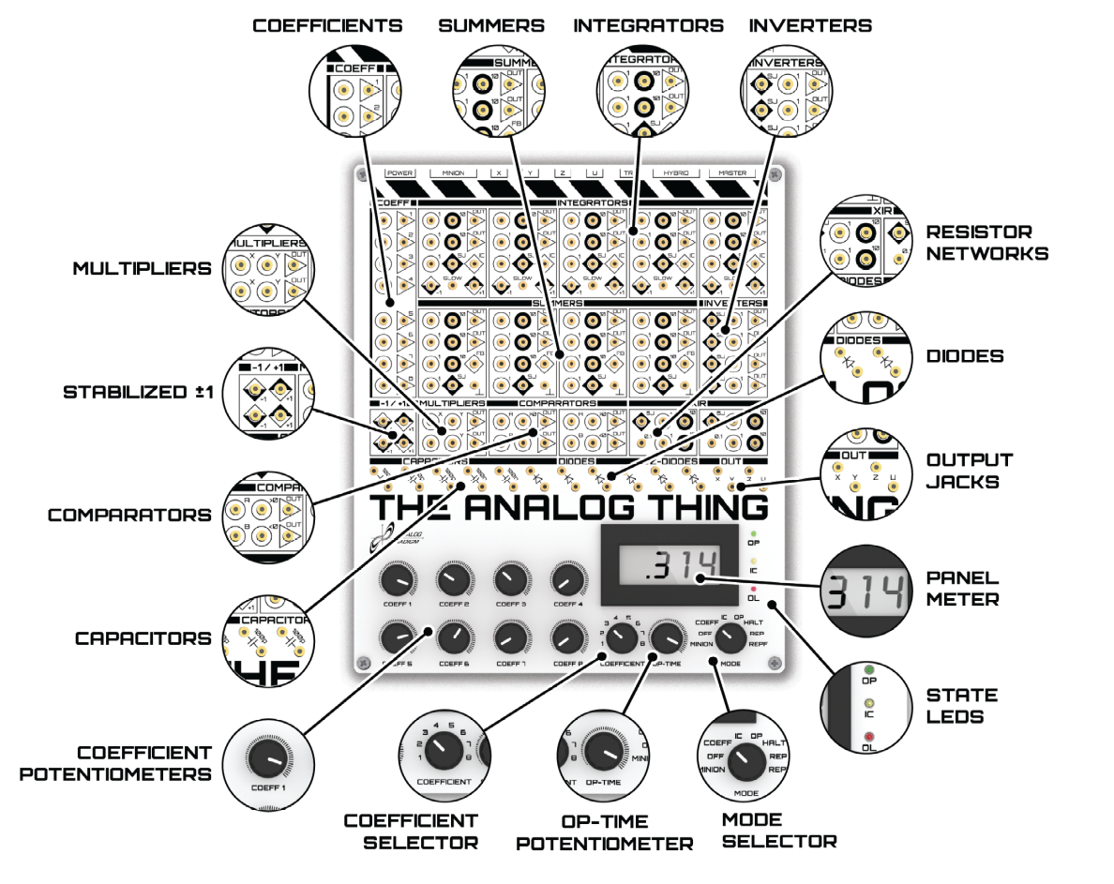
(picture
from our website)

Slide 16
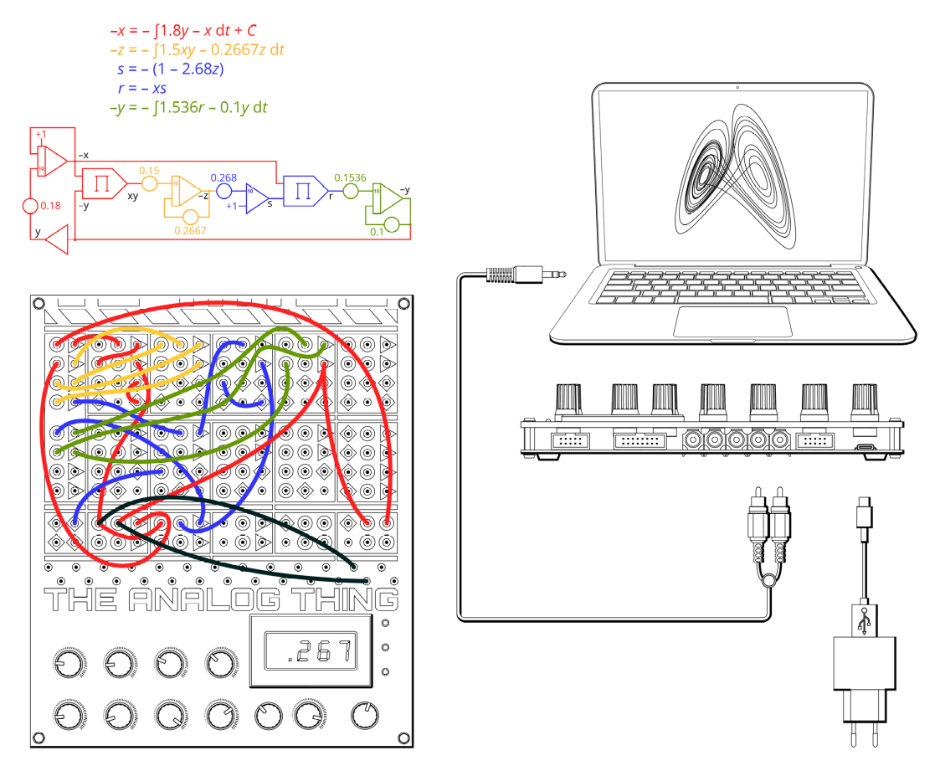
(picture
from our manual)

Slide 17
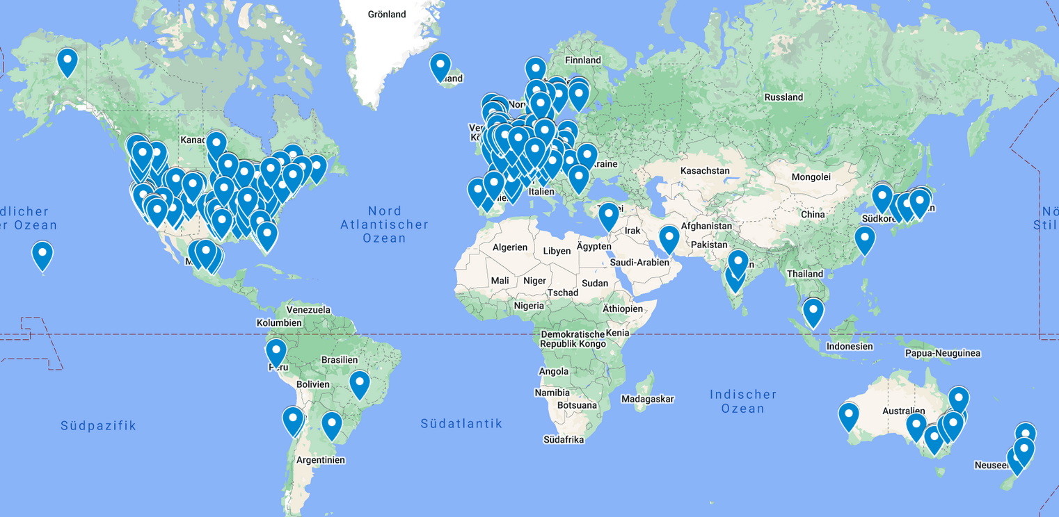

Slide 18

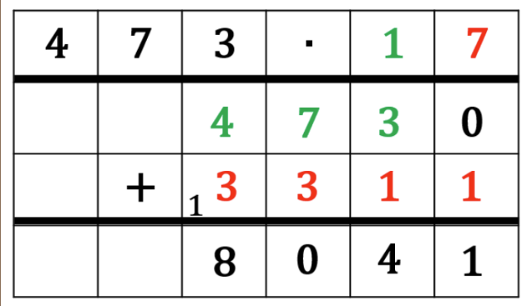
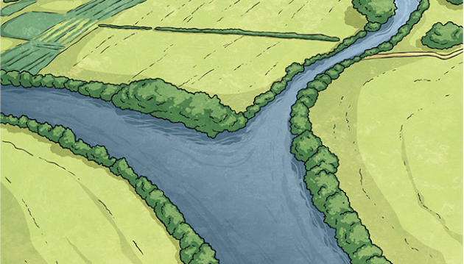
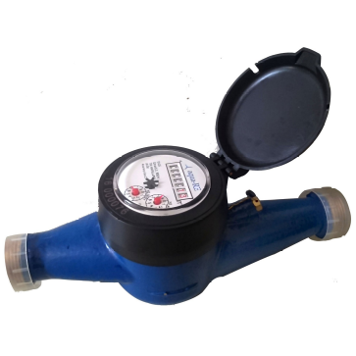
Analogues
Digital Arithmetics
Analog processes in nature
b
a
a+b=c
• Uses algorithms
• Inherently clocked and serial
• Based on memory
• Energy barrier, von-Neumann bottleneck
• Happens in real-time
• Continous and parallel
• Initial state preparation and
Measurement-based
• Resetting Moore’s law

Slide 19
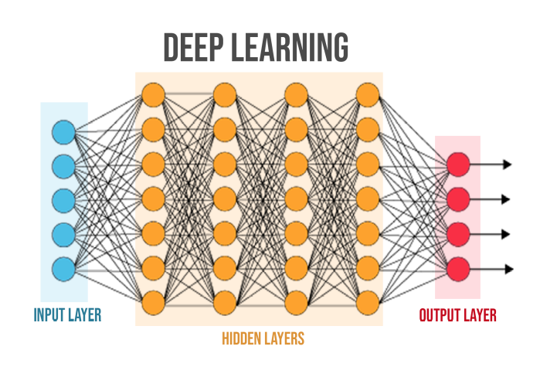
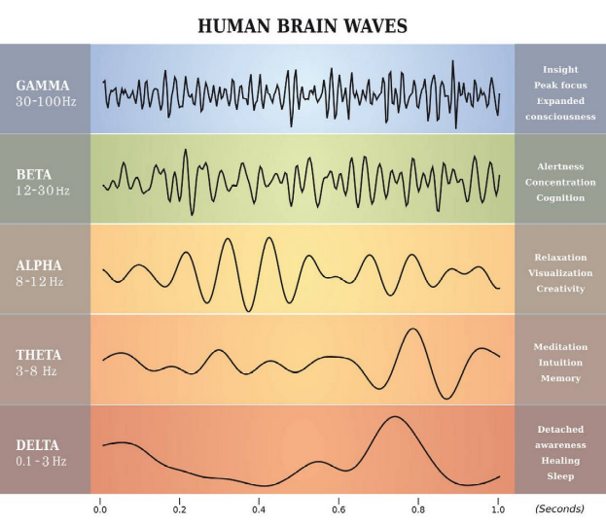
Compute as the Human Brain
Digital Arithmetics
Analog processes in nature
Symbolic computing & sparse linear algebra
Wave-based computing & dense interconnects

Slide 20
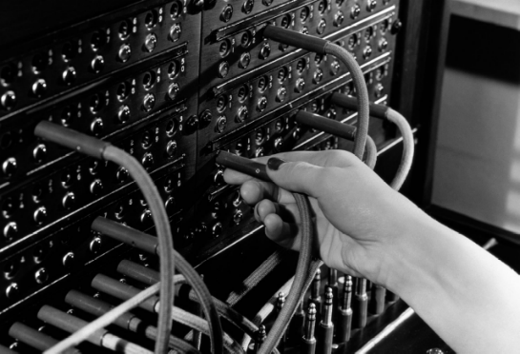
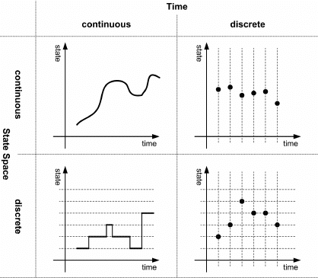
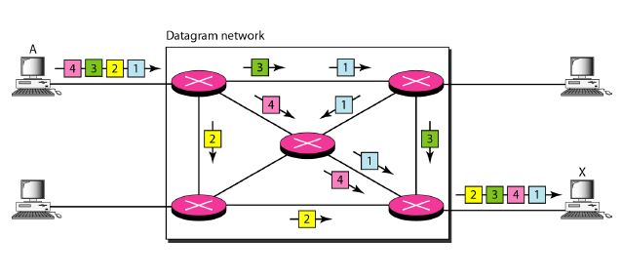
Telephone switchboard
[10.14279/tuj.eceasst.27.385]
Ethernet switch

Slide 21
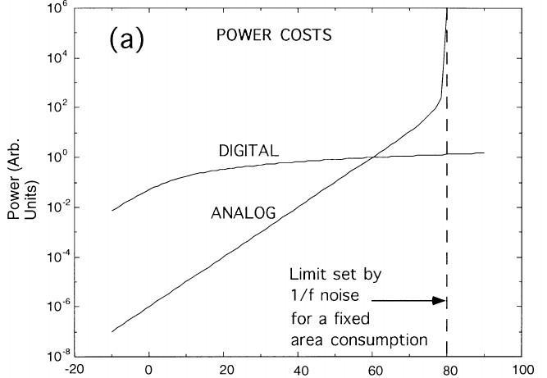
← Wenig Bits
Viele Bits →
Sarpeshkar, Neural Computation 10, 1601–1638 (1998)

Slide 22
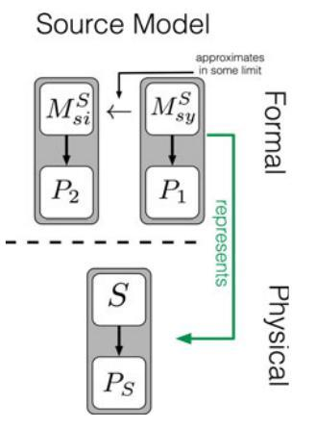
analog
vs
analogue
[10.14279/tuj.eceasst.27.385]
[Hangleiter, Carolan, Thébault: Analogue Quantum Simulation, p.18]

Slide 23
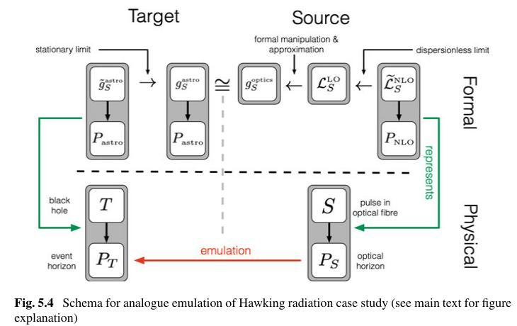
Emulation of Hawking Radiation in Dispersive Optical Media
[Hangleiter, Carolan, Thébault: Analogue Quantum Simulation]

Slide 24
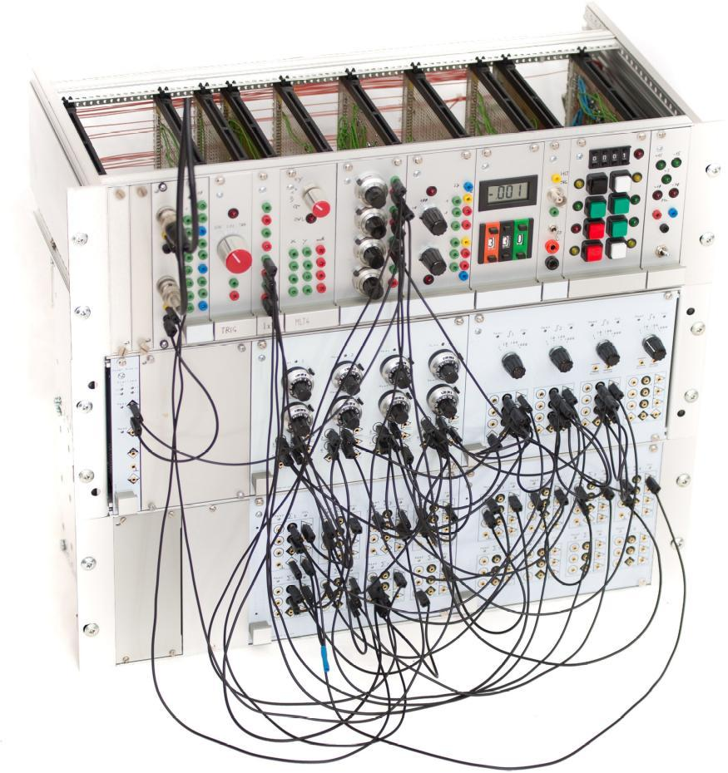
Die Rückkehr des
Analogrechners
Namensgebend ist die Analogiebildung mit elektrischen Schaltkreisen.
Intrinsisch parallele Datenfluss-verarbeitung statt sequentieller Algorithmen.
Extrem energieeffizient:
„Jedes Elektron zählt“.
Kontinuierliche Werte und kontinuierliche Zeit: Kein Takt.

Slide 25
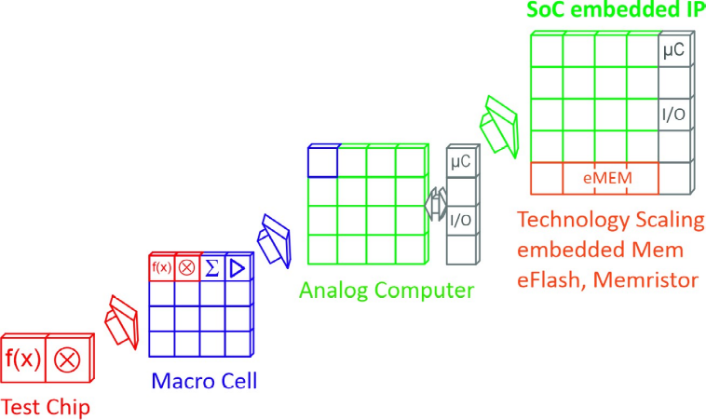
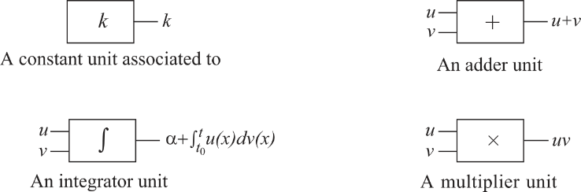
Building blocks: The General Purpose Analog Computer (GPAC)
Milestones and
Tapeouts at anabrid
Computing model by Claude Shannon [1941]
Black box model
No algorithm, no memory (beyond state variables)
All computing elements compute at same time
Bildquellen: Daniel Graca http://www.dp-pmi.org/uploads/3/8/1/3/3813936/shannon_2016.pdf

Slide 26
Scaling analog CMOS for HPC
Anabrid resets Moore’s law
Circuit Size
[# computing elements]
Cutoff Frequency
[Hz]
Nuclear Fusion
10¹²
10⁹
Growth:
One Decade per Year
...
10⁸
10⁸
Growth:
One Decade per 2 years
HPC
HPC
10⁷
10⁶
10⁷
GPAC2
Drones
10⁵
10⁶
GPAC1
10⁴
REDAC
10³
10⁵
LUCI, REDAC
Embedded
10²
LUCI
Digital limit
10¹
THAT
10⁴
THAT
2020 2022 2024 2026 2028 2030
Time
[year]
2020 2022 2024 2026 2028 2030
Time
[year]

Slide 27
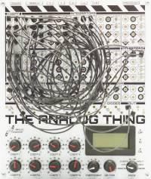
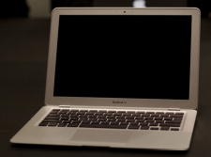
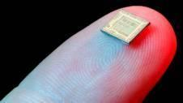
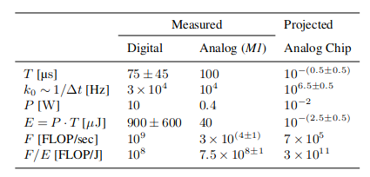
Power and Time to Solution Measurements and Projections for the GPAC
Integrated
Analog
Computer on
Chip
Discrete
Analog
Computer
Integrated Digital benchmark
Time to Solution:
Cutoff frequency (bandwith):
Power consumption:
Energy for computation:
(effective) FLOPs:
Efficiency (FLOPS per Energy):
Köppel et al
[arXiV:2102.07268]

Slide 28
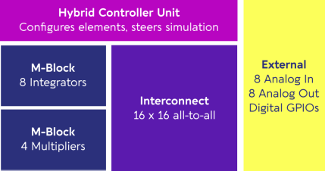
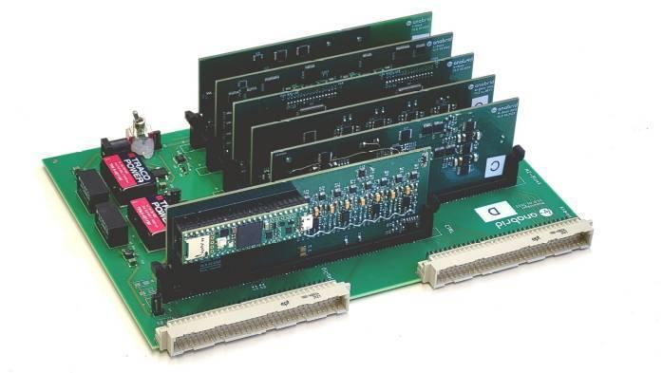
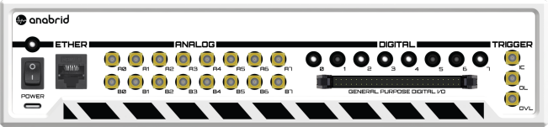
A milestone last year: First fully-reconfigurable discrete analog computer
Precision
Up to 12bit resolution.
DC accuracy 0.1%
AC bandwidth > 1Mhz (cutoff frequency).

Slide 29
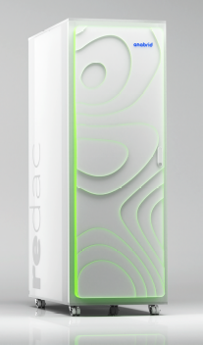
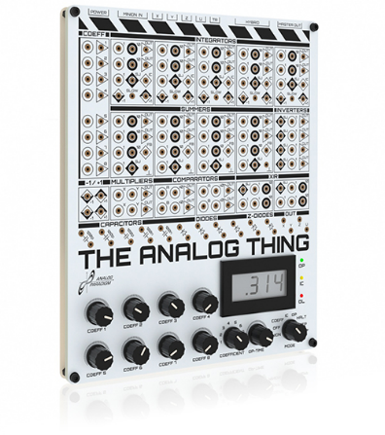
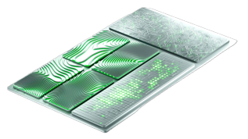

Towards 1e5 computing elements on chip
„Resetting Moore’s law“ at 65nm
The Analog Thing
»Hacker’s toolkit«
REDAC Analog Supercomputer
G-PAC: 65nm CMOS
2027 -> 22nm

Slide 30
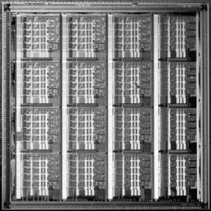
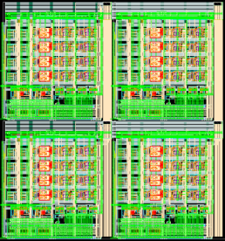
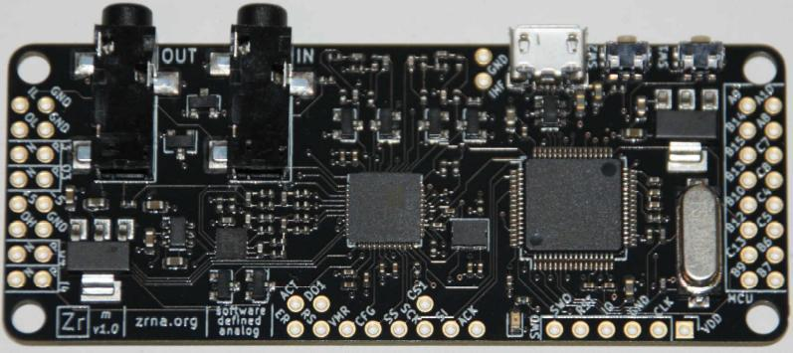
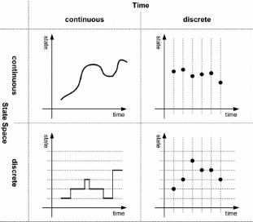
First Chip-level integrated Analog Computers
Existing: Highly Specialized Chips, low bandwith, rather large statical/dynamical errors, near to no software support
Glenn Cowan 2005
(A VLSI Analog Computer, PhD Thesis, Columbia University)
Ning Guo et al. 2016
(Energy-Efficient Hybrid A/D Approx Comp. In Continous Time, IEEE Journal of Solid-State-Circuits)
Anadigm Inc. and
ZRNA (open source)
Switched capacitor configurable
analog blocks (CABs)
[http://zrna.org]
[10.14279/tuj.eceasst.27.385]

Slide 31
Analog Computing Toolchain as we built it today
THAT wiring guide
Human patcher
Hardware description
SPICE simulation
Crossbar configuration
Reconfigurable Analog Computer
Time evolution result
Differential equations
„Compiler“
VHDL code
FPGA
Algorithmic ODE solver

Slide 32









anabrid tech stack (industry audience)
Integrations
WebGUI
Analog Cloud
Quantum circuits
Optimization problem
PDEs
ML/AI
THATWizard
Libraries
analib
lucipy
Compiler
redacc
pybrid
THAT
REDAC
LUCIDAC
Hardware

Slide 33
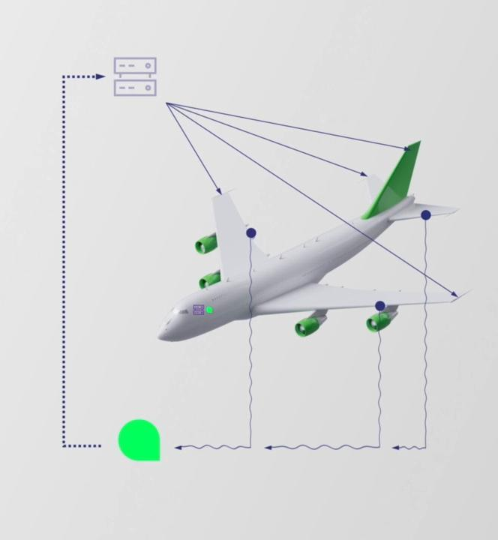

Reasons why to go analog
Talking to industry
Low
Latency
100%
Parallelism
Low
Power
Reduced
Complexity

Slide 34


Solving industry problems with Analog CMOS
The General Purpose Analog Computer by Claude Shannon [1941]
Mapping Turing Machines to Polynomial Initial Value Problems
[Sarpeshkar, Neural Computation, 10, 1601-1638 (1998)] [Köppel et al. Advances in Radio Science 2020 / Arxiv:2102.07268] [Bournez, Pouly 2016]

Slide 35

Implementing APIs
solve_ode( @(t,u)
diff(rho,t) = div(p),
diff(p_i, t) = div(p_i*v_j – p*dela_ij),
diff(e, t) = div(v_i*(e+p)),
p = rho*eps*(Gamma-1)
)
Anabrids Hardware Description Language
[Köppel et al. Advances in Radio Science 2020 / Arxiv:2102.07268]

Slide 36

Implementing APIs
solve_ode( @(t,u)
diff(rho,t) = div(p),
diff(p_i, t) = div(p_i*v_j – p*dela_ij),
diff(e, t) = div(v_i*(e+p)),
p = rho*eps*(Gamma-1)
)
Anabrids Hardware Description Language

Slide 37

Data flow programming
Configuring op-amp circuits

Slide 38

Analog Computing on FPGAs
Digital Differential Analysers
Exploit massive amount of Multiply-Add Units
32bit fixed point (16bit integer, 16bit fractional)
Toy problems: Rössler attractor, Hindmarsh-Rose Neuron.
Utilization about 11%
Old Nexys 4 DDR FPGA board, 100Mhz

Slide 39

[THAT Booklet]

Slide 40



DSL ODE input
Verilog output
PWM to DSO: „dense solution“
Micro benchmark:
FPGA: 1W
THAT: 0.4W
G-PAC: 10mW

Slide 41
Analog architectures on FPGAs and ASICs
Dr. Sven Köppel
koeppel@anabrid.com
Thank you for your attention!
2025-07-14, 10:30 AM
Paderborn Center for Parallel Computing (PC2)
PC2 Seminar at U Paderborn
Room X0.101, Mersingweg 5, 33098 Paderborn

